Slide 1
Predicting credit card offer acceptance based on customer characteristics
In this presentation, we will be exploring the characteristics of customers who are likely to accept credit card offers. Credit card services are a crucial source of revenue for the bank, and understanding the demographics and characteristics of customers who are more likely to accept these offers can help the bank optimize its marketing strategy and increase revenue. Through a focused marketing study of 18,000 bank customers, we will be analyzing existing demographic data to identify patterns and make predictions about future customer behavior.

Slide 2
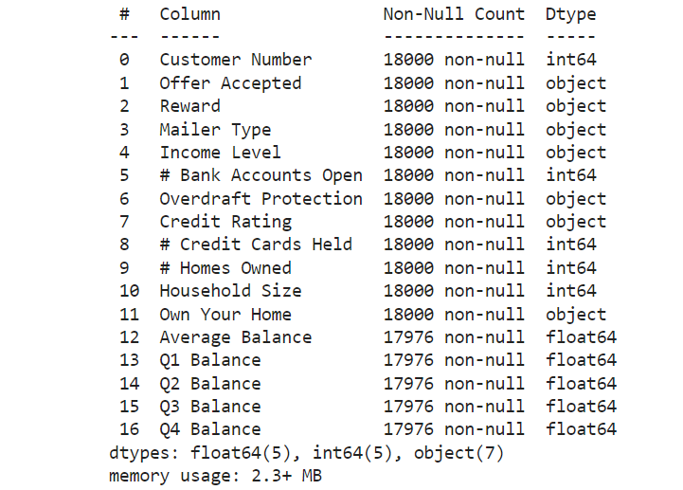
Understanding data set used in the project

Slide 3
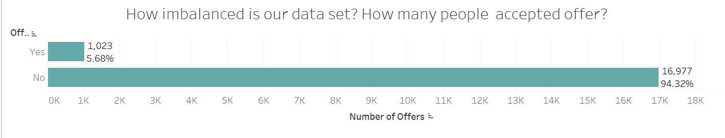
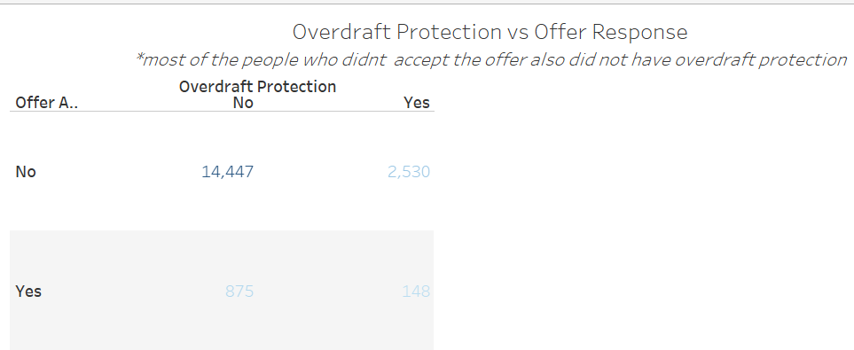
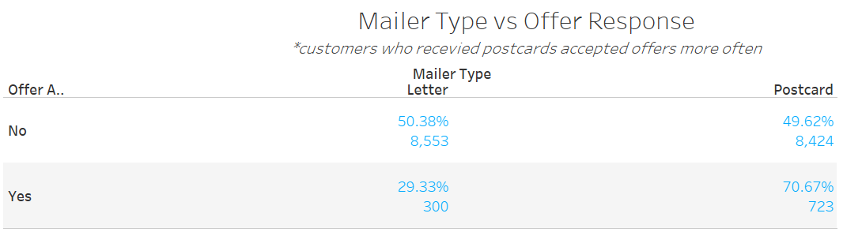

EXPLORING CUSTOMER DATA FOR CREDIT CARD OFFER ACCEPTANCE
THE FIRST THING I REALIZE IS IMBALANCED DATA THAT CAN CAUSE ISSUE FOR OUR MACHINE LEARNING MODEL..
..MOST OF THE PEOPLE WHO DID NOT ACCEPT THE OFFER ALSO DON’T HAVE OVERDRAFT PROTECTION..
..CUSTOMERS WHO RECEVIED POSTCARDS ACCEPTED OFFERS MORE OFTEN..
..CUSTOMERS WITH CREDIT BELOW HIGH ARE MORE LIKELY TO ACCEPT OFFER!
COST SAVINGS

Slide 4
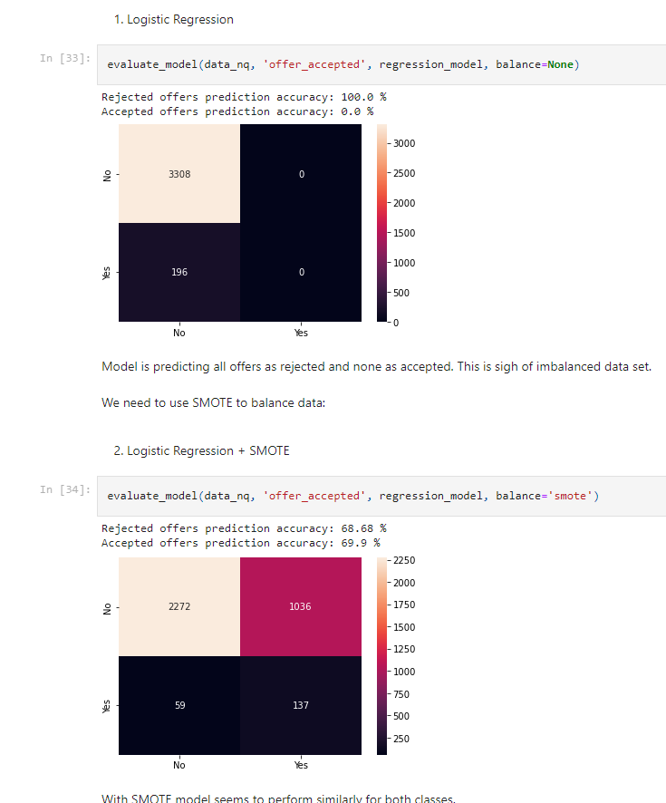
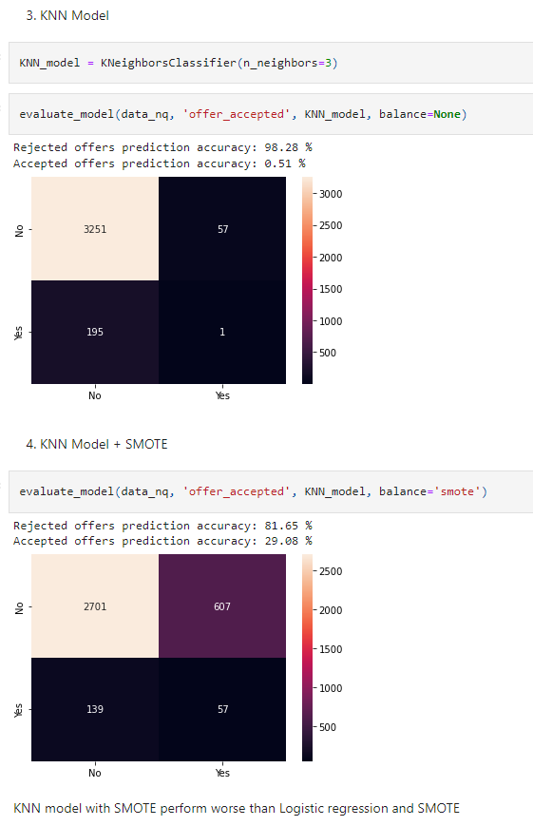
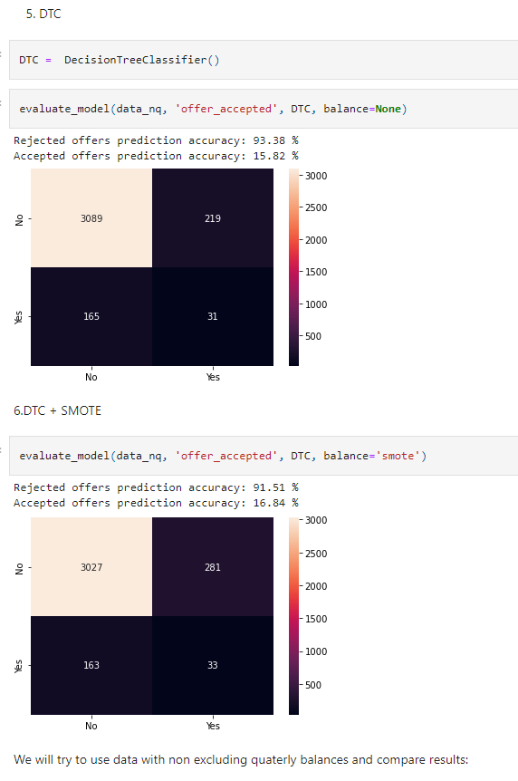
Model Selection and Evaluation

Slide 5
Growth strategy
Our future marketing should focus on customers with lower credit card ratings
invent new offer types to attract customers with high rating
Find a new way to introduce existing customers with all benefitsand services
Simplify the redemption process
Offer a sign-up bonus

Slide 6
THANK YOU
Ivan Radic
630-589-9479
ivanradic90@gmail.com

